Slide 1
Data Structure & Algorithm
Lecture 3: Sort-Part 1
Dr. Mohamed Ezz
Al-Azhar University

Slide 2
Agenda
Why Sorting
The Bubble Sort
The Selection Sort
The Insertion Sort
Merge Sort
Quick Sort

Slide 3
Why Sorting?
Practical application
  People by last name
  Countries by population
  Search engine results by relevance
Fundamental to other algorithms
Different algorithms have different asymptotic and constant-factor trade-offs
  No single ‘best’ sort for all scenarios
  Knowing one way to sort just isn’t enough
Many to approaches to sorting which can be used for other problems

Slide 4
Problem statement
There are n comparable elements in an array and we want to rearrange them to be in increasing order
Pre:
  An array A of data records
  A value in each data record
  A comparison function
    <, =, >, compareTo
Post:
  For each distinct position i and j of A,
    if i<j then A[i] ≤ A[j]
  A has all the same data it started with

Slide 5
Sorting Classification
In memory sorting |  |  | External sorting
Comparison sorting |  | Specialized Sorting
O(N²) | O(N log N) | O(N) | # of tape accesses
Bubble Sort Selection Sort Insertion Sort Shell Sort | Merge Sort Quick Sort Heap Sort | Bucket Sort Radix Sort | Simple External Merge Sort Variations

Slide 6
O(n²) Comparison Sorting

Slide 7
Bubble sort
bubble sort: orders a list of values by repetitively comparing neighboring elements and swapping their positions if necessary
more specifically:
  scan the list, exchanging adjacent elements if they are not in relative order; this bubbles the highest value to the top
  scan the list again, bubbling up the second highest value
  repeat until all elements have been placed in their proper order

Slide 8
"Bubbling" largest element
Traverse a collection of elements
  Move from the front to the end
  "Bubble" the largest value to the end using pair-wise comparisons and swapping
Swap
0 1 2 3 4 5
42
77
77
42
35
12
101
5

Slide 9
"Bubbling" largest element
Traverse a collection of elements
  Move from the front to the end
  "Bubble" the largest value to the end using pair-wise comparisons and swapping
0 1 2 3 4 5
Swap
35
77
42
77
35
12
101
5

Slide 10
"Bubbling" largest element
Traverse a collection of elements
  Move from the front to the end
  "Bubble" the largest value to the end using pair-wise comparisons and swapping
0 1 2 3 4 5
Swap
12
77
42
35
77
12
101
5

Slide 11
"Bubbling" largest element
Traverse a collection of elements
  Move from the front to the end
  "Bubble" the largest value to the end using pair-wise comparisons and swapping
0 1 2 3 4 5
42
35
12
77
101
5
No need to swap

Slide 12
"Bubbling" largest element
Traverse a collection of elements
  Move from the front to the end
  "Bubble" the largest value to the end using pair-wise comparisons and swapping
0 1 2 3 4 5
Swap
5
101
42
35
12
77
101
5

Slide 13
"Bubbling" largest element
Traverse a collection of elements
  Move from the front to the end
  "Bubble" the largest value to the end using pair-wise comparisons and swapping
0 1 2 3 4 5
101
42
35
12
77
5
Largest value correctly placed

Slide 14
Algorithm
1. Do step 3 for i = 0 up to n –1.
2. Do step 3 for j = 1 up to n –1-i.
3. If the two consecutive elements sj and sj+1, are out of order, swap them.

Slide 15
Sorting Program
public class SortArray {
public static void main(String[] args) {
int[] a = {42,77,35,12,101,5};
    print(a);
    bubbleSort(a);
    print(c);
  } ///end main
public static void print(int[] a) {
System.out.printf("{%d", a[0]);
for (int i = 1; i < a.length; i++) {
System.out.printf(", %d", a[i]);
}
System.out.println("}");
}
public static void swap(int[] a, int x,int y) {
int temp= a[x];
a[y]=a[x];
a[x]=temp
}

Slide 16
Bubble sort code
public static void bubbleSort(int[] a) {
for (int i = 0; i < a.length; i++) {
for (int j = 1; j < a.length - i; j++) {
// swap adjacent out-of-order elements
if (a[j-1] > a[j]) {
swap(a, j-1, j);
}
}
}
}//end class

Slide 17
Bubble sort runtime
Running time (# comparisons) for input size n:
  number of actual swaps performed depends on the data; out-of-order data performs many swaps
T(n)

Slide 18
Selection sort
selection sort: orders a list of values by repetitively putting a particular value into its final position
more specifically:
  find the smallest value in the list
  switch it with the value in the first position
  find the next smallest value in the list
  switch it with the value in the second position
  repeat until all values are in their proper places

Slide 19
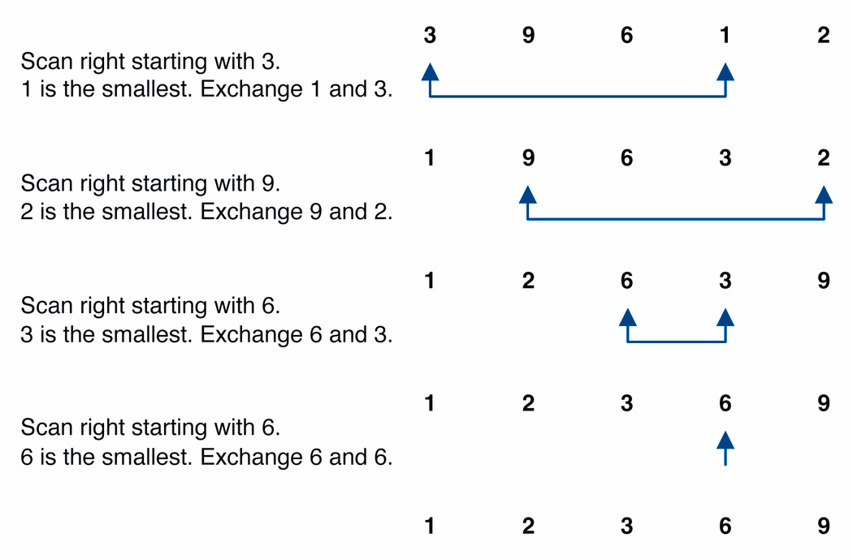
Selection sort example

Slide 20
Selection sort example 2
Index | 0 | 1 | 2 | 3 | 4 | 5 | 6 | 7
Value | 27 | 63 | 1 | 72 | 64 | 58 | 14 | 9
1st pass | 1 | 63 | 27 | 72 | 64 | 58 | 14 | 9
2nd pass | 1 | 9 | 27 | 72 | 64 | 58 | 14 | 63
3rd pass | 1 | 9 | 14 | 72 | 64 | 58 | 27 | 63
…
Notes:
The selection sort marks the first element (27). It then goes through the remaining
data to find the smallest number(1). It swaps this with the first element and the smallest element is now in its correct position. It then marks the second element (63) and looks through the remaining data for the next smallest number (9). These two numbers are then swapped. This process continues until n-1 passes have been made.

Slide 21
Algorithm
1. Do steps 2–4 for i = 0 up to n –1 .
2. Do step 3 for j = i+1 up to n –1.
3. Locate the index m of the smallest element among {si . . sn} .
4. Swap si and sm.

Slide 22
Sorting Program
public class SortArray {
public static void main(String[] args) {
int[] a = {42,77,35,12,101,5};
    print(a);
    selectionSort(a);
    print(c);
  } ///end main
public static void print(int[] a) {
System.out.printf("{%d", a[0]);
for (int i = 1; i < a.length; i++) {
System.out.printf(", %d", a[i]);
}
System.out.println("}");
}
public static void swap(int[] a, int x,int y) {
int temp= a[x];
a[y]=a[x];
a[x]=temp
}

Slide 23
Selection sort code
public static void selectionSort(int[] a) {
for (int i = 0; i < a.length; i++) {
// find index of smallest element
int minIndex = i;
for (int j = i + 1; j < a.length; j++) {
if (a[j] < a[minIndex]) {
minIndex = j;
}
}
// swap smallest element with a[i]
swap(a, i, minIndex);
}
}//end class

Slide 24
Selection sort runtime
Running time for input size n:
  In practice, a bit faster than bubble sort. Why?
T(n)
Notes:
faster because fewer swaps are made. (Constant c is smaller on O(n^2).)

Slide 25
Insertion sort
insertion sort: orders a list of values by repetitively inserting a particular value into a sorted subset of the list
more specifically:
  consider the first item to be a sorted sublist of length 1
  insert the second item into the sorted sublist, shifting the first item if needed
  insert the third item into the sorted sublist, shifting the other items as needed
  repeat until all values have been inserted into their proper positions

Slide 26
Insertion sort
Simple sorting algorithm.
  n-1 passes over the array
  At the end of pass i, the elements that occupied A[0]…A[i] originally are still in those spots and in sorted order.
2 | 15 | 8 | 1 | 17 | 10 | 12 | 5
0 | 1 | 2 | 3 | 4 | 5 | 6 | 7
after
pass 2
2 | 8 | 15 | 1 | 17 | 10 | 12 | 5
0 | 1 | 2 | 3 | 4 | 5 | 6 | 7
after
pass 3
1 | 2 | 8 | 15 | 17 | 10 | 12 | 5
0 | 1 | 2 | 3 | 4 | 5 | 6 | 7

Slide 27
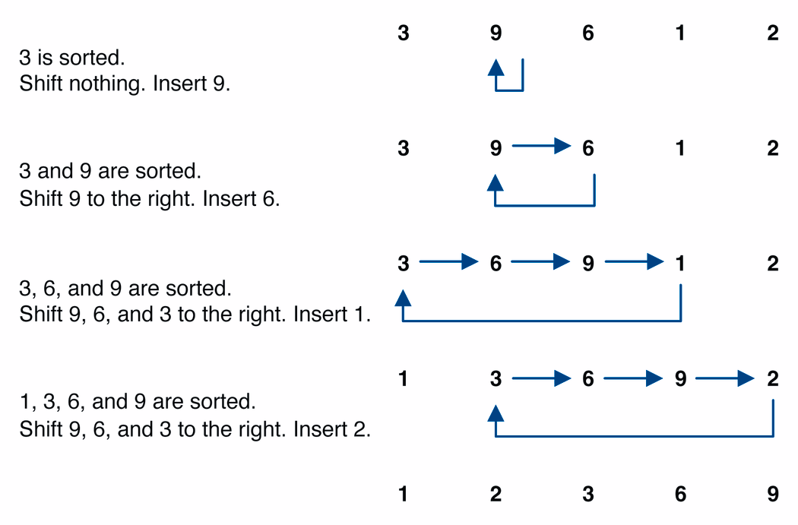
Insertion sort example

Slide 28
Algorithm
1. Do steps 2–5 for i = 1 up to n –1.
2. Hold the element si in a temporary space.
3. Do step 4 for j = i down to 0 as long as sj-1> temporary space.
4. Shift the subsequence {sj . . . si–1} up one position to {sj+1 . . . si}.
5. Copy the held value of si (tempary) into sj.

Slide 29
Sorting Program
public class SortArray {
public static void main(String[] args) {
int[] a = {42,77,35,12,101,5};
    print(a);
    insertionSort(a);
    print(c);
  } ///end main
public static void print(int[] a) {
System.out.printf("{%d", a[0]);
for (int i = 1; i < a.length; i++) {
System.out.printf(", %d", a[i]);
}
System.out.println("}");
}
public static void swap(int[] a, int x,int y) {
int temp= a[x];
a[y]=a[x];
a[x]=temp
}

Slide 30
Insertion sort code
public static void insertionSort(int[] a) {
for (int i = 1; i < a.length; i++) {
int temp = a[i];
// slide elements down to make room for a[i]
int j = i;
while (j > 0 && a[j - 1] > temp) {
a[j] = a[j - 1];
j--;
}
a[j] = temp;
}
}

Slide 31
Insertion sort runtime
worst case: reverse-ordered elements in array.
best case: array is in sorted ascending order.
average case: each element is about halfway in order.
T(n)=
T(n)=
T(n)=

Slide 32
Comparing sorts
We've seen "simple" sorting algorithms so far, such as selection sort and insertion sort.
They all use nested loops and perform approximately n² comparisons
They are relatively inefficient

Slide 33
Comparing sorts
 | Bubble |  | Selection |  | Insertion
 | Comparison | Swap | Comparison | Swap | Comparison | Swap
Worst | O(n²) | O(n²) | O(n²) | O(n) | O(n²) | O(n²)
Average | O(n²) | O(n²) | O(n²) | O(n) | O(n²) | O(n)
Best | O(n²) | 0 | O(n) | 0 | O(n) | n copy

Slide 34
Home Work
Write a Class for Called Facebook application which contains four arrays:
  userName
  eMail
  phone
  Password
The Program should has the following methods:
  void insertUser((String, userName,String eMail, String phone, String password)
  void deleteUser(int index)
  void displayUser(int index)
  int searchUser(String name)
  void displayAll()
  void storeToFile(String fileName)
  void retrieveFromFile(String fileName)

